Slide 1
Chapter 4 CPU Scheduling (Algorithms)

Slide 2
Chapter 4: CPU Scheduling
4.1 Basic Concepts
4.2 Scheduling Criteria
4.3 Scheduling Algorithms
4.4 Multiple-Processor Scheduling

Slide 3
4.1 Basic Concepts

Slide 4
Basic Concepts
Maximum CPU utilization is obtained with multiprogramming
Several processes are kept in memory at one time
Every time a running process has to wait, another process can take over use of the CPU
Scheduling of the CPU is fundamental to operating system design
Process execution consists of a cycle of a CPU time burst and an I/O time burst (i.e. wait) as shown on the next slide
Processes alternate between these two states (i.e., CPU burst and I/O burst)
Eventually, the final CPU burst ends with a system request to terminate execution

Slide 5
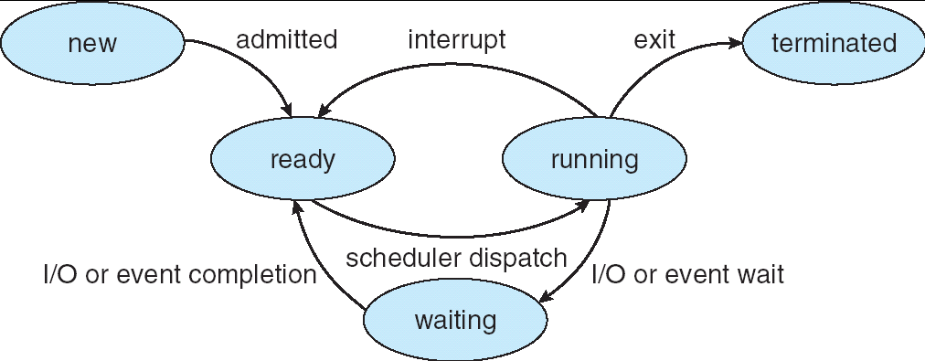
CPU Scheduler
The CPU scheduler selects from among the processes in memory that are ready to execute and allocates the CPU to one of them
CPU scheduling is affected by the following set of circumstances:
1. (N) A process switches from running to waiting state
2. (P) A process switches from running to ready state
3. (P) A process switches from waiting to ready state
4. (N) A processes switches from running to terminated state
Circumstances 1 and 4 are non-preemptive; they offer no schedule choice
Circumstances 2 and 3 are pre-emptive; they can be scheduled

Slide 6
4.2 Scheduling Criteria

Slide 7
Scheduling Criteria
Different CPU scheduling algorithms have different properties
The choice of a particular algorithm may favor one class of processes over another
In choosing which algorithm to use, the properties of the various algorithms should be considered
Criteria for comparing CPU scheduling algorithms may include the following
CPU utilization – percent of time that the CPU is busy executing a process
Throughput – number of processes that are completed per time unit
Response time – amount of time it takes from when a request was submitted until the first response occurs (but not the time it takes to output the entire response)
Waiting time – the amount of time before a process starts after first entering the ready queue (or the sum of the amount of time a process has spent waiting in the ready queue)
Turnaround time – amount of time to execute a particular process from the time of submission through the time of completion

Slide 8
Optimization Criteria
It is desirable to
Maximize CPU utilization
Maximize throughput
Minimize turnaround time
Minimize start time
Minimize waiting time
Minimize response time
In most cases, we strive to optimize the average measure of each metric
In other cases, it is more important to optimize the minimum or maximum values rather than the average

Slide 9
4.3 Single Processor Scheduling Algorithms

Slide 10
Single Processor Scheduling Algorithms
First Come, First Served (FCFS)
Shortest Job First (SJF)
Priority
Round Robin (RR)

Slide 11
First Come, First Served (FCFS) Scheduling

Slide 12

FCFS Scheduling Example
suppose the scheduler is given 4 tasks, A, B, C and D. Each task requires a certain number of time units to complete.
The FCFS scheduler’s Gantt chart for these tasks would be:
The OS incurs some overhead each time it switches between processes due to context switching. We will call this overhead “cs”.
CPU Utilization -26/(26+3cs)
Turn around time - (8+12+21+26+6cs)/4 = 16.5 ignoring cs
Waiting-(0+8+12+21+6cs)/4 = 10.25 ignoring cs
Throughput-4/(26 + 3cs)
Response-(0+8+cs+12+2cs+21+3cs)/4 = 10.25 ignoring cs
Task | Time units
A | 8
B | 4
C | 9
D | 5

Slide 13
First-Come, First-Served (FCFS) Scheduling
Process Burst Time
P₁ 24
P₂ 3
P₃ 3
With FCFS, the process that requests the CPU first is allocated the CPU first
Case #1: Suppose that the processes arrive in the order: P₁ , P₂ , P₃ The Gantt Chart for the schedule is:
Waiting time for P₁ = 0; P₂ = 24; P₃ = 27
Average waiting time: (0 + 24 + 27)/3 = 17
Average turn-around time: (24 + 27 + 30)/3 = 27
P₁
P₂
P₃
0
24
27
30

Slide 14
FCFS Scheduling (Cont.)
Case #2: Suppose that the processes arrive in the order: P₂ , P₃ , P₁
The Gantt chart for the schedule is:
Waiting time for P₁ = 6; P₂ = 0; P₃ = 3
Average waiting time: (6 + 0 + 3)/3 = 3 (Much better than Case #1)
Average turn-around time: (3 + 6 + 30)/3 = 13
Case #1 is an example of the convoy effect; all the other processes wait for one long-running process to finish using the CPU
This problem results in lower CPU and device utilization; Case #2 shows that higher utilization might be possible if the short processes were allowed to run first
The FCFS scheduling algorithm is non-preemptive
Once the CPU has been allocated to a process, that process keeps the CPU until it releases it either by terminating or by requesting I/O
It is a troublesome algorithm for time-sharing systems
P₂
P₃
P₁
0
3
6
30

Slide 15
Shortest Job First (SJF) Scheduling

Slide 16
Shortest-Job-First (SJF) Scheduling
The SJF algorithm associates with each process the length of its next CPU burst
When the CPU becomes available, it is assigned to the process that has the smallest next CPU burst (in the case of matching bursts, FCFS is used)
Two schemes:
Nonpreemptive – once the CPU is given to the process, it cannot be preempted until it completes its CPU burst
Preemptive – if a new process arrives with a CPU burst length less than the remaining time of the current executing process, preempt. This scheme is know as the Shortest-Remaining-Time-First (SRTF)

Slide 17
Example #1: Non-Preemptive SJF
Process Arrival Time Burst Time
P₁ 0.0 7
P₂ 2.0 4
P₃ 4.0 1
P₄ 5.0 4
SJF (non-preemptive, varied arrival times)
Average waiting time = ( (0 – 0) + (8 – 2) + (7 – 4) + (12 – 5) )/4 = (0 + 6 + 3 + 7)/4 = 4
Average turn-around time: = ( (7 – 0) + (12 – 2) + (8 - 4) + (16 – 5))/4 = ( 7 + 10 + 4 + 11)/4 = 8
P₁
P₃
P₂
P₄
0
3
7
8
12
16
Waiting time : sum of time that a process has spent waiting in the ready queue

Slide 18

Q2
Ex:2
Process | Burst Time | Arrival | Start | Wait | Finish | TAT
P1 | 10 | 0 | 10 | 10 | 20 | 20
P2 | 29 | 0 | 32 | 32 | 61 | 61
P3 | 3 | 0 | 0 | 0 | 3 | 3
P4 | 7 | 0 | 3 | 3 | 10 | 10
P5 | 12 | 0 | 20 | 20 | 32 | 32
Gantt chart:
Average waiting time: (10+32+0+3+20)/5 = 13
Average turnaround time: (10+39+42+49+61)/5 = 25.2

Slide 19
Example #3: Preemptive SJF (Shortest-remaining-time-first)
Process Arrival Time Burst Time
P₁ 0.0 7
P₂ 2.0 4
P₃ 4.0 1
P₄ 5.0 4
SJF (preemptive, varied arrival times)
Average waiting time = ( [(0 – 0) + (11 - 2)] + [(2 – 2) + (5 – 4)] + (4 - 4) + (7 – 5) )/4 = (9 + 1 + 0 + 2)/4 = 3 Average turn-around time = (16-0) + (7-2) + (5-4) +( 11-5)/4 = 7
P₁
P₂
P₃
P₂
P₄
P₁
0
2
4
5
7
11
16
Waiting time : sum of time that a process has spent waiting in the ready queue

Slide 20

Ex4
Process | Burst Time | Arrival | Start | Wait | Finish | TA
P1 | 8 | 0 | 0 | 9 | 17 | 17
P2 | 4 | 1 | 1 | 0 | 5 | 4
P3 | 9 | 2 | 17 | 15 | 26 | 24
P4 | 5 | 3 | 5 | 2 | 10 | 7
Gantt chart: Average waiting time: [(0-0)+(10-1)]+(1-1)+(17-2)+(5-3))/4 = 6.5
Average turnaround time: (17-0)+(5-1)+(26-2)+(10-3)/4 = 13

Slide 21
Exponential Averaging
τ _{n+1} = α t_{n} + (1 − α) ) τ_{n}
τ_{n+1} : predicted length of next CPU burst
t_{n} : actual length of last CPU burst
τ_{n} : previous prediction
α = 0 implies make no use of recent history
(τ_{n+1} = τ_{n})
α = 1 implies τ_{n+1} = t_{n} (past prediction not used).
α = 1/2 implies weighted (older bursts get less and less weight).

Slide 22
Priority Scheduling

Slide 23
Priority Scheduling
The SJF algorithm is a special case of the general priority scheduling algorithm
A priority number (integer) is associated with each process
The CPU is allocated to the process with the highest priority (smallest integer = highest priority)
Priority scheduling can be either preemptive or non-preemptive
A preemptive approach will preempt the CPU if the priority of the newly-arrived process is higher than the priority of the currently running process
A non-preemptive approach will simply put the new process (with the highest priority) at the head of the ready queue
SJF is a priority scheduling algorithm where priority is the predicted next CPU burst time
The main problem with priority scheduling is starvation, that is, low priority processes may never execute
A solution is aging; as time progresses, the priority of a process in the ready queue is increased

Slide 24

Priority Scheduling example
Process | Burst Time | Priority | Arrival | Start | Wait | Finish | TA
P1 | 10 | 3 | 0 | 6 | 6 | 16 | 16
P2 | 1 | 1 | 0 | 0 | 0 | 1 | 1
P3 | 2 | 4 | 0 | 16 | 16 | 18 | 18
P4 | 1 | 5 | 0 | 18 | 18 | 19 | 19
P5 | 5 | 2 | 0 | 1 | 1 | 6 | 6
Gantt chart:
Average waiting time: (6+0+16+18+1)/5 = 8.2
Average turnaround time: (16+1+18+19+6)/5 = 12

Slide 25
Round Robin (RR) Scheduling

Slide 26
Round Robin (RR) Scheduling
In the round robin algorithm, each process gets a small unit of CPU time (a time quantum), usually 10-100 milliseconds. After this time has elapsed, the process is preempted and added to the end of the ready queue.
If there are n processes in the ready queue and the time quantum is q, then each process gets 1/n of the CPU time in chunks of at most q time units at once. No process waits more than (n-1)q time units.
Performance of the round robin algorithm
q large ⇒ FCFS
q small ⇒ q must be greater than the context switch time; otherwise, the overhead is too high
One rule of thumb is that 80% of the CPU bursts should be shorter than the time quantum

Slide 27
Example of RR with Time Quantum = 20
Process Burst Time
P₁ 53
P₂ 17
P₃ 68
P₄ 24
The Gantt chart is:
Typically, higher average turnaround than SJF, but better response time
Average waiting time = ( [(0 – 0) + (77 - 20) + (121 – 97)] + (20 – 0) + [(37 – 0) + (97 - 57) + (134 – 117)] + [(57 – 0) + (117 – 77)] ) / 4 = (0 + 57 + 24) + 20 + (37 + 40 + 17) + (57 + 40) ) / 4 = (81 + 20 + 94 + 97)/4 = 292 / 4 = 73
Average turn-around time = 134 + 37 + 162 + 121) / 4 = 113.5
P₁
P₂
P₃
P₄
P₁
P₃
P₄
P₁
P₃
P₃
0
20
37
57
77
97
117
121
134
154
162

Slide 28

Example 2 (q = 4):
Process | Burst Time | Arrival | Start | Wait | Finish | TA
1 | 24 | 0 | 0 | 6 | 30 | 30
2 | 3 | 0 | 4 | 4 | 7 | 7
3 | 3 | 0 | 7 | 7 | 10 | 10
Gantt chart: Average waiting time: (6+4+7)/3 = 5.67
Average turnaround time: (30+7+10)/3 = 15.67

Slide 29
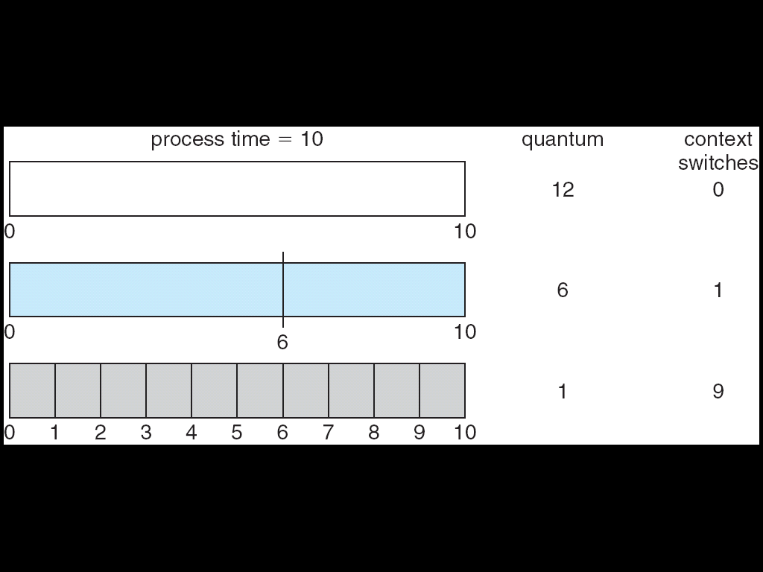
Time Quantum and Context Switches

Slide 30
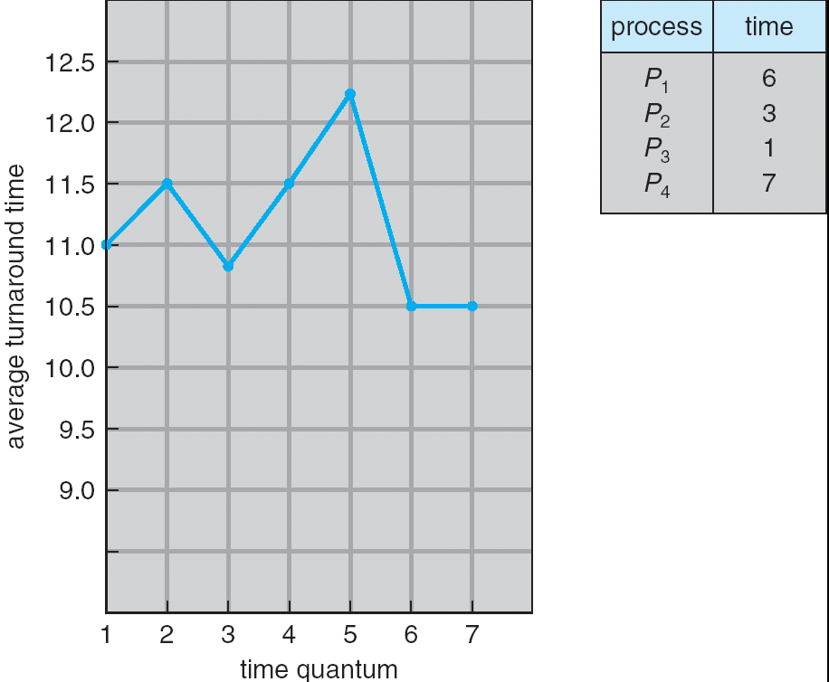
Turnaround Time Varies With The Time Quantum
As can be seen from this graph, the average turnaround time of a set of processes does not necessarily improve as the time quantum size increases. In general, the average turnaround time can be improved if most processes finish their next CPU burst in a single time quantum.

Slide 31
4.3b Multi-level Queue Scheduling

Slide 32
Multi-level Queue Scheduling
Multi-level queue scheduling is used when processes can be classified into groups
For example, foreground (interactive) processes and background (batch) processes
The two types of processes have different response-time requirements and so may have different scheduling needs
Also, foreground processes may have priority (externally defined) over background processes
A multi-level queue scheduling algorithm partitions the ready queue into several separate queues
The processes are permanently assigned to one queue, generally based on some property of the process such as memory size, process priority, or process type
Each queue has its own scheduling algorithm
The foreground queue might be scheduled using an RR algorithm
The background queue might be scheduled using an FCFS algorithm
In addition, there needs to be scheduling among the queues, which is commonly implemented as fixed-priority pre-emptive scheduling
The foreground queue may have absolute priority over the background queue

Slide 33
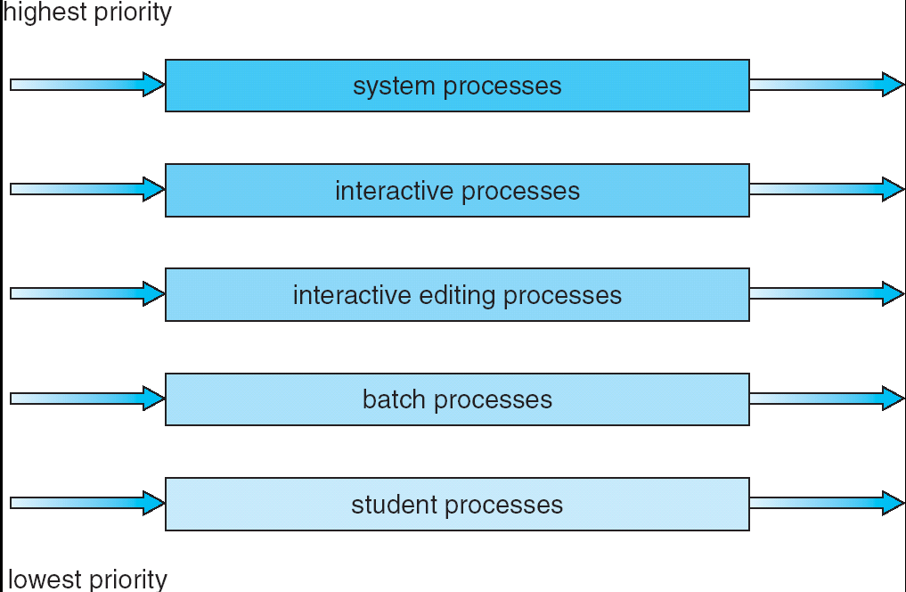
Multi-level Queue Scheduling
One example of a multi-level queue are the five queues shown below
Each queue has absolute priority over lower priority queues
For example, no process in the batch queue can run unless the queues above it are empty
However, this can result in starvation for the processes in the lower priority queues

Slide 34
Multilevel Queue Scheduling
Another possibility is to time slice among the queues
Each queue gets a certain portion of the CPU time, which it can then schedule among its various processes
The foreground queue can be given 80% of the CPU time for RR scheduling
The background queue can be given 20% of the CPU time for FCFS scheduling

Slide 35
Multilevel Queue Scheduling
Assume there are 2 queues:- Q1(using RR scheduling with quantum =8) for
foreground processes and Q2(using FCFS scheduling) for background processes.
Consider following processes arriving in the system
Process Burst time Type
P1 12 FG
P2 8 BG
P3 20 FG
P4 7 BG
Calculate average waiting time assuming that processes in Q1 will be executed
first.(Fixed priority scheduling)
0 8 16 20 28 32 40 47
Waiting time of P1=(20-12) =8
Waiting time of P2 = (40-8)=32
Waiting time of P4 =(47-7)=40
Waiting time of P3 = (32-20)= 12
Average waiting time = (8 + 32 + 40 + 12)/4=23
P1 Q1 | P3 Q1 | P1 Q1 | P3 Q1 | P3 Q1 | P2 Q2 | P4 Q2

Slide 36
4.3 Multi-level Feedback Queue Scheduling

Slide 37
Multilevel Feedback Queue Scheduling
In multi-level feedback queue scheduling, a process can move between the various queues; aging can be implemented this way.
A multilevel-feedback-queue scheduler is defined by the following parameters:
Number of queues
Scheduling algorithms for each queue
Method used to determine when to promote a process
Method used to determine when to demote a process
Method used to determine which queue a process will enter when that process needs service

Slide 38
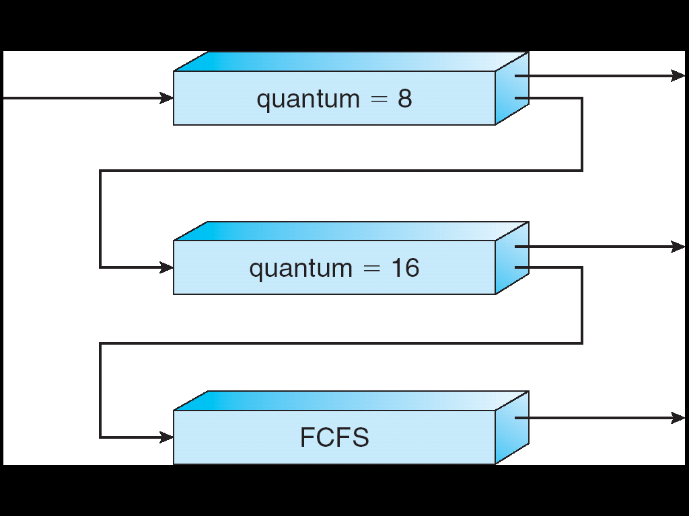
Example of Multilevel Feedback Queue
Scheduling
A new job enters queue Q₀ (RR) and is placed at the end. When it gains the CPU, the job receives 8 milliseconds. If it does not finish in 8 milliseconds, the job is moved to the end of queue Q₁.
A Q₁ (RR) job receives 16 milliseconds. If it still does not complete, it is preempted and moved to queue Q₂ (FCFS).
Q₀
Q₁
Q₂

Slide 39
Multilevel Feedback Queues
Consider the following set of processes:
Processes Arrival time Burst time Waiting Time
P1 0 17
P2 12 25
P3 28 8
P4 36 32
P5 46 18

Slide 40
4.4 Multiple-Processor Scheduling

Slide 41
Multiple-Processor Scheduling
If multiple CPUs are available, load sharing among them becomes possible; the scheduling problem becomes more complex
We concentrate in this discussion on systems in which the processors are identical (homogeneous) in terms of their functionality
We can use any available processor to run any process in the queue
Two approaches: Asymmetric processing and symmetric processing (see next slide)

Slide 42
Multiple-Processor Scheduling
Asymmetric multiprocessing (ASMP)
One processor handles all scheduling decisions, I/O processing, and other system activities
The other processors execute only user code
Because only one processor accesses the system data structures, the need for data sharing is reduced
Symmetric multiprocessing (SMP)
Each processor schedules itself
All processes may be in a common ready queue or each processor may have its own ready queue
Either way, each processor examines the ready queue and selects a process to execute
Efficient use of the CPUs requires load balancing to keep the workload evenly distributed
In a Push migration approach, a specific task regularly checks the processor loads and redistributes the waiting processes as needed
In a Pull migration approach, an idle processor pulls a waiting job from the queue of a busy processor
Virtually all modern operating systems support SMP, including Windows XP, Solaris, Linux, and Mac OS X

Slide 43
Symmetric Multithreading
Symmetric multiprocessing systems allow several threads to run concurrently by providing multiple physical processors
An alternative approach is to provide multiple logical rather than physical processors
Such a strategy is known as symmetric multithreading (SMT)
This is also known as hyperthreading technology
The idea behind SMT is to create multiple logical processors on the same physical processor
This presents a view of several logical processors to the operating system, even on a system with a single physical processor
Each logical processor has its own architecture state, which includes general-purpose and machine-state registers
Each logical processor is responsible for its own interrupt handling
However, each logical processor shares the resources of its physical processor, such as cache memory and buses.
SMT is a feature provided in the hardware, not the software
The hardware must provide the representation of the architecture state for each logical processor, as well as interrupt handling (see next slide)

Slide 44
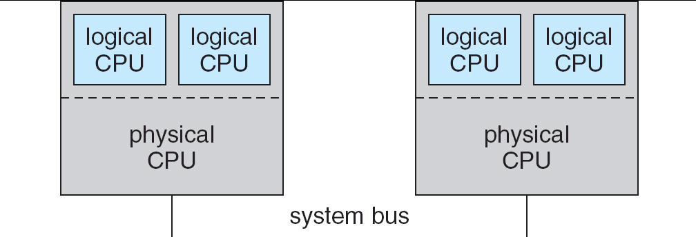
A typical SMT architecture
SMT = Symmetric Multi-threading

